Slide 1

Projectile Motion

Slide 2
Table Of Contents
Introduction
Mathematical Model Equations
Numerical Method used To solve the equations
Main Functions Used In MATLAB
Graphical User Interface
3D Simulink Model
Results
References

Slide 3
Introduction
Projectile motion is a combination of horizontal and vertical motion. A projectile is an object upon which the only force acting is gravity.
Experience the power of visualization as you explore the world of projectile With this interactive simulation, you can input the initial conditions of a projectile: its initial velocity (v0), launch angle, and starting positions in the x and y directions (x0 and y0). Witness the trajectory of the projectile come to life as it plots in real-time. But that's not all! We've taken it a step further by providing visual aids to enhance your understanding.
Imagine a scenario where you have a target situated 165 meters away from your position. Your task is to find the perfect angle to launch a projectile with an initial velocity of 35 m/s, so that it precisely hits the target. This challenge calls for a 3D simulation in MATLAB

Slide 4
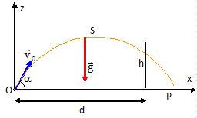
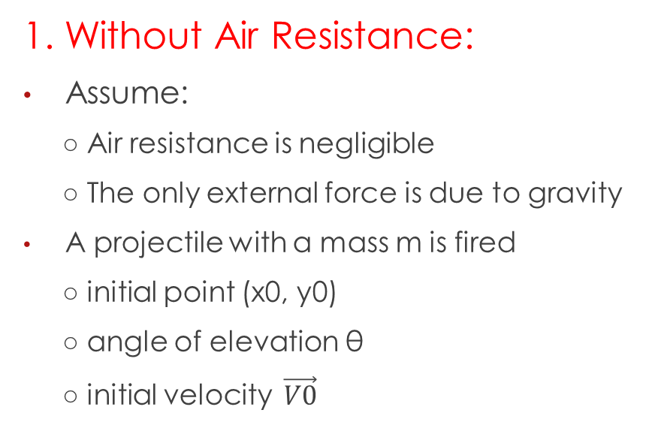
Mathematical Model Equations
1. Without Air Resistance:
Assume:
○ Air resistance is negligible
○ The only external force is due to gravity
A projectile with a mass m is fired
○ initial point (x0, y0)
○ angle of elevation θ
○ initial velocity $\vec{V0}$

Slide 5

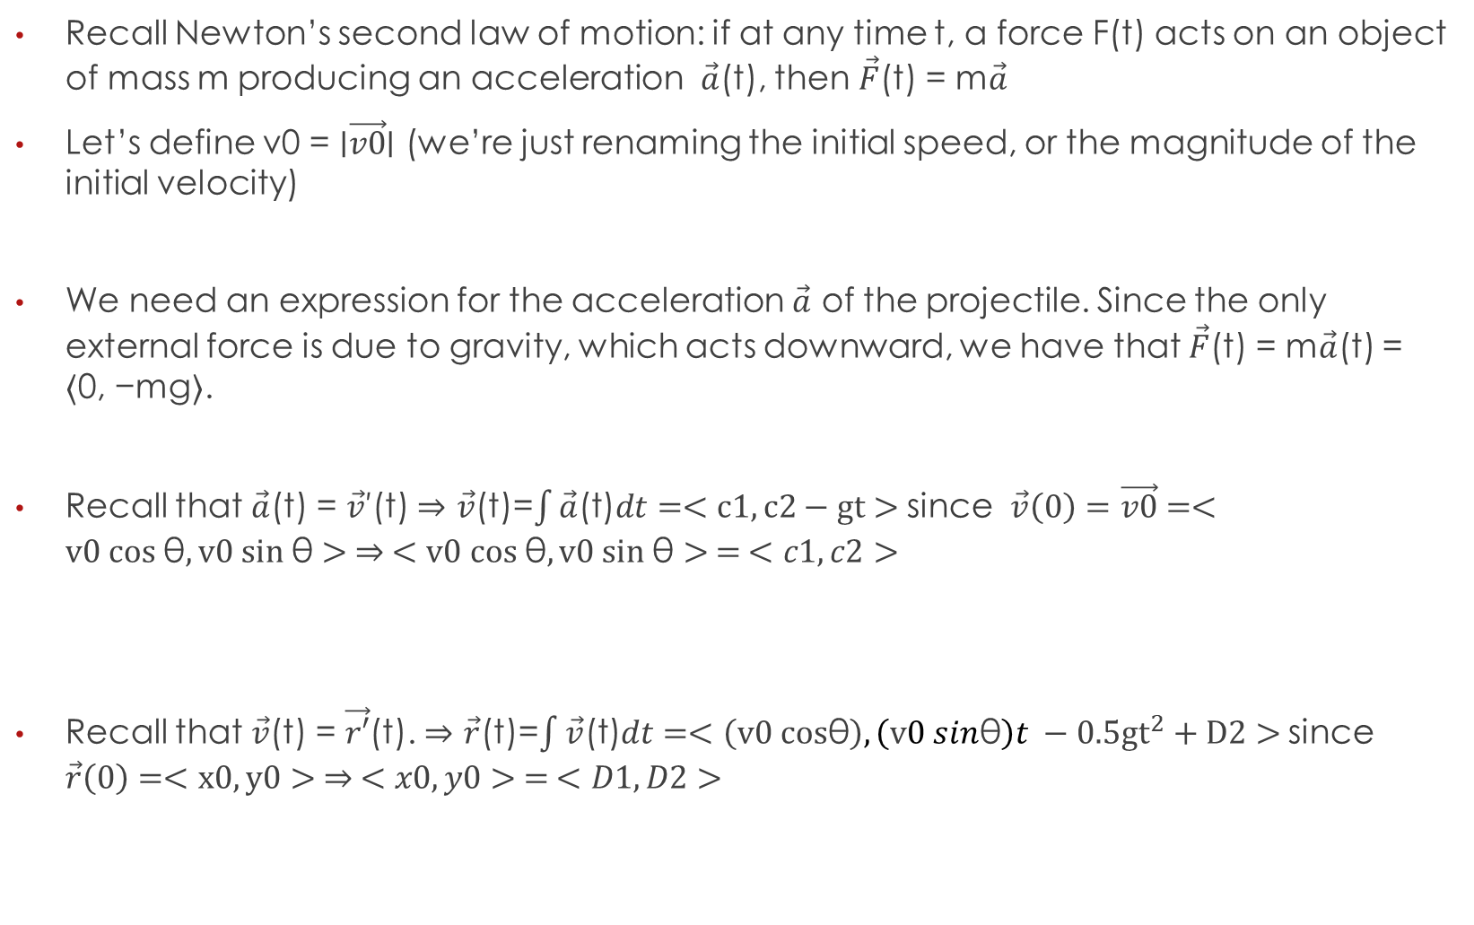


Recall Newton’s second law of motion: if at any time t, a force F(t) acts on an object of mass m producing an acceleration $\vec{a}$(t), then $\vec{F}$(t) = m$\vec{a}$
Let’s define v0 = ∣$\vec{v0}$∣ (we’re just renaming the initial speed, or the magnitude of the initial velocity)
We need an expression for the acceleration $\vec{a}$ of the projectile. Since the only external force is due to gravity, which acts downward, we have that $\vec{F}$(t) = m$\vec{a}$(t) = ⟨0, −mg⟩.
Recall that $\vec{a}$(t) = $\vec{v}$′(t) $⇒$ $\vec{v}$(t)=$\int{\vec{a}\text{(}\text{t}\text{)}dt}=<c1,c2−gt>$ since $\vec{v}\left(0\right)=\vec{v0}=<v0 cos \text{θ},v0 sin \text{θ}> ⇒ <v0 cos \text{θ},v0 sin \text{θ}> = <c1,c2>$
Recall that $\vec{v}$(t) = $\vec{r′}$(t). $⇒$ $\vec{r}$(t)=$\int{\vec{v}\text{(}\text{t}\text{)}dt}=<\left(v0 cos\text{θ}\right),\left(v0 sin\text{θ}\right)t −0.5{gt}^{2}+D2>$ since $\vec{r}\left(0\right)=<x0,y0> ⇒ <x0,y0> = <D1,D2>$
$$\vec{v0}=<V0 cos\text{θ},V0 sin\text{θ}\text{ >}$$
$$\vec{a}\left(t\right)=<0,−g>$$
$$\vec{v}=<v0 cos\text{θ},v0 sin\text{θ}\text{ −}\text{gt}>$$
$$\vec{r}=<(v0 cos\text{θ}\text{)}t+x0,(v0 sin\text{θ}\text{)}\text{t}\text{ −}0.5{gt}^{2}+y0 >$$

Slide 6

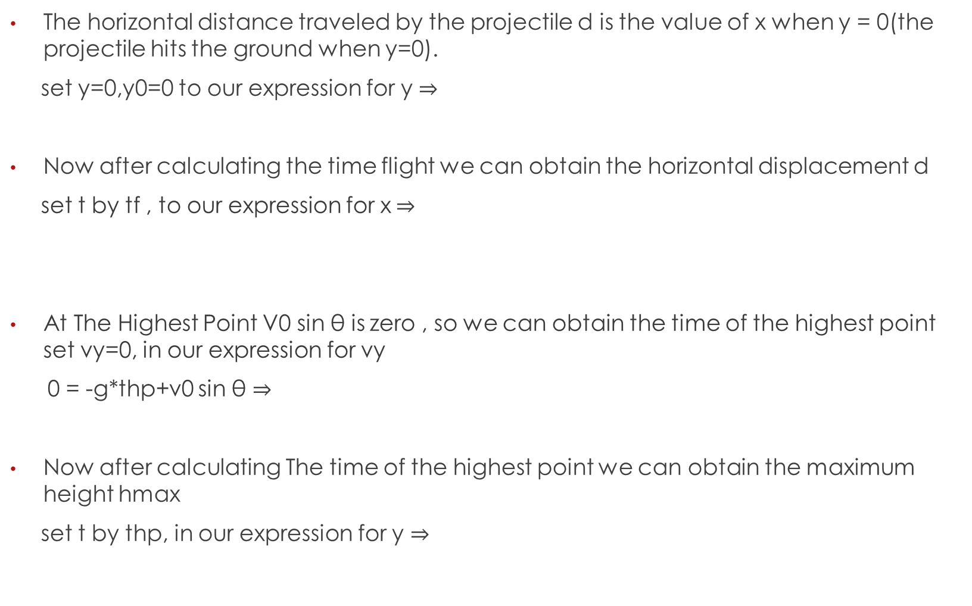
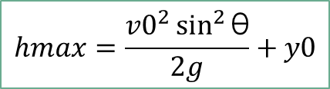

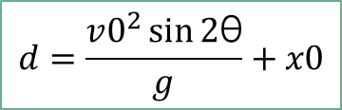
The horizontal distance traveled by the projectile d is the value of x when y = 0(the projectile hits the ground when y=0).
set y=0,y0=0 to our expression for y $⇒$
Now after calculating the time flight we can obtain the horizontal displacement d
set t by tf , to our expression for x$⇒$
At The Highest Point V0 sin $\text{θ}$ is zero , so we can obtain the time of the highest point set vy=0, in our expression for vy
0 = -g*thp+v0 sin $\text{θ}$ $⇒$
Now after calculating The time of the highest point we can obtain the maximum height hmax
set t by thp, in our expression for y $⇒$
$$tf=2\frac{v0\sin{\text{θ}}}{g}$$
$$d=\frac{v0^{2}\sin{2\text{θ}}}{g}+x0$$
$$thp=\frac{v0\sin{\text{θ}}}{g}$$
$$hmax=\frac{v0^{2}\sin^{2}{\text{θ}}}{2g}+y0$$

Slide 7
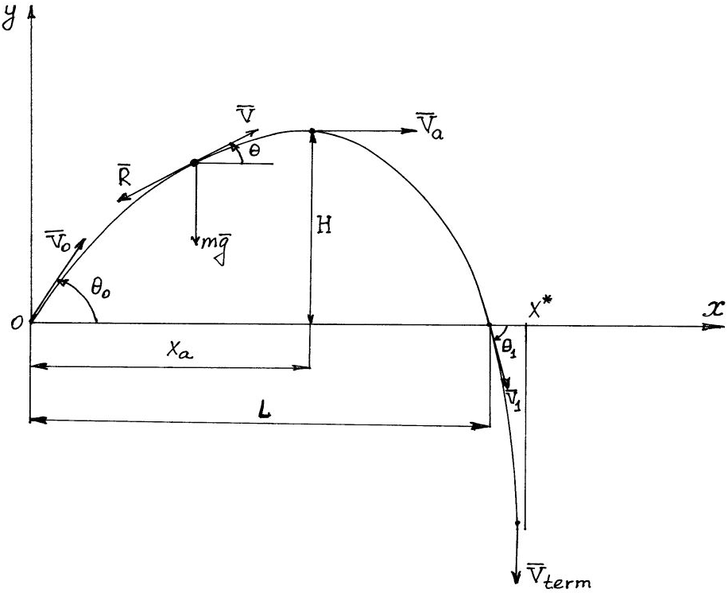
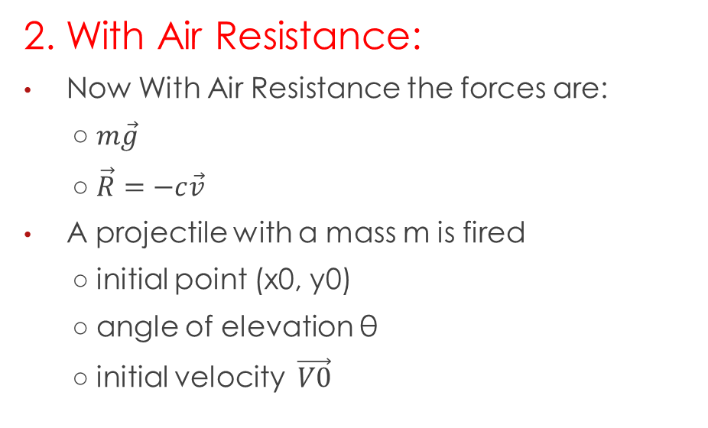
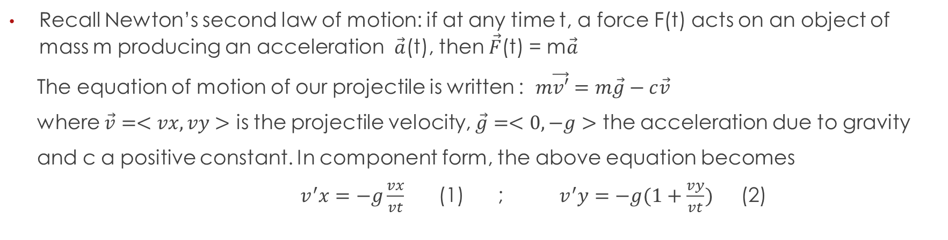
2. With Air Resistance:
Now With Air Resistance the forces are:
○ $m\vec{g}$
○ $\vec{R}=−c\vec{v}$
A projectile with a mass m is fired
○ initial point (x0, y0)
○ angle of elevation θ
○ initial velocity $\vec{V0}$
Recall Newton’s second law of motion: if at any time t, a force F(t) acts on an object of mass m producing an acceleration $\vec{a}$(t), then $\vec{F}$(t) = m$\vec{a}$
The equation of motion of our projectile is written : $m\vec{v′}=m\vec{g}−c\vec{v}$
where $\vec{v}=<vx,vy>$ is the projectile velocity, $\vec{g}=<0,−g>$ the acceleration due to gravity
and c a positive constant. In component form, the above equation becomes
$v^{′}x=−g\frac{vx}{vt}$ (1) ; $v^{′}y=−g(1+\frac{vy}{vt})$ (2)

Slide 8

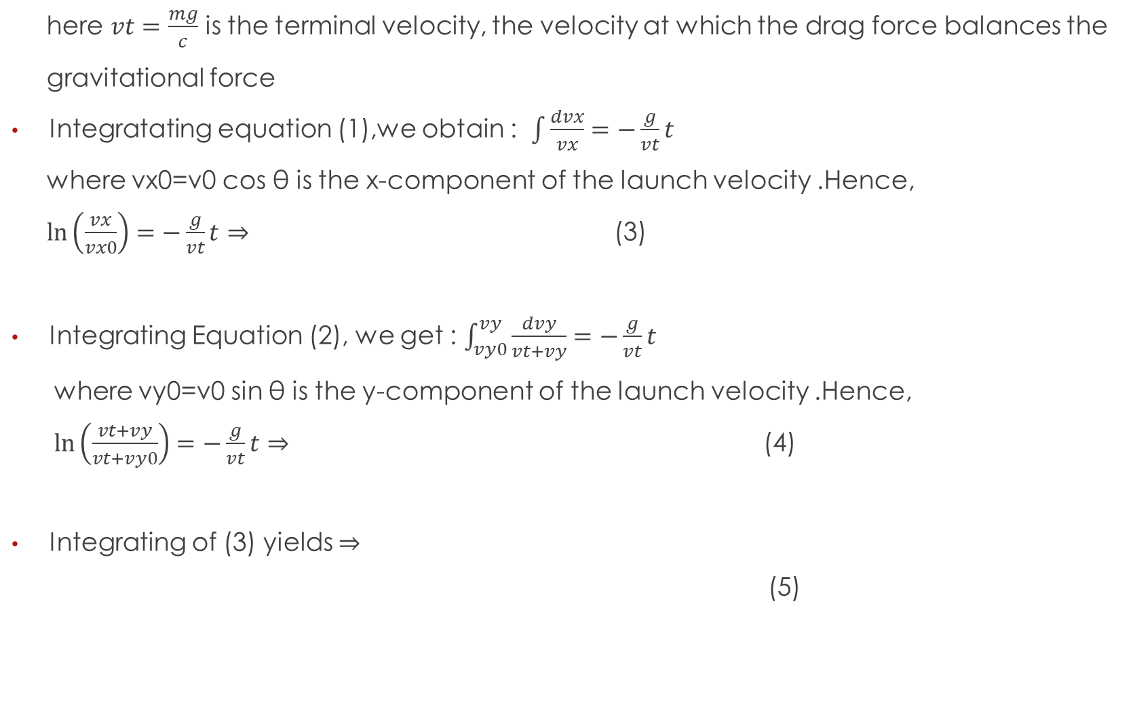
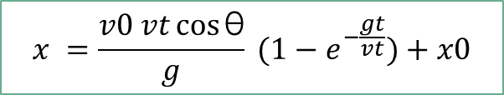

here $vt=\frac{mg}{c}$ is the terminal velocity, the velocity at which the drag force balances the
gravitational force
Integratating equation (1),we obtain : $\int{\frac{dvx}{vx}=−\frac{g}{vt}t}$
where vx0=v0 cos θ is the x-component of the launch velocity .Hence,
$\ln\left(\frac{vx}{vx0}\right)=−\frac{g}{vt}t$ $⇒$ (3)
Integrating Equation (2), we get : $\int_{vy0}^{vy}{\frac{dvy}{vt+vy}=−\frac{g}{vt}t}$
where vy0=v0 sin θ is the y-component of the launch velocity .Hence,
$\ln\left(\frac{vt+vy}{vt+vy0}\right)=−\frac{g}{vt}t$ $⇒$ (4)
Integrating of (3) yields $⇒$
(5)
$$vx=v0\cos{\text{θ}} e^{−\frac{gt}{vt}}$$
$$vy=v0\sin{\text{θ}{ e}^{−\frac{gt}{vt}}}−vt{(1−e}^{−\frac{gt}{vt}})$$
$$x =\frac{v0 vt\cos{\text{θ}}}{g} {(1−e}^{−\frac{gt}{vt}})+x0$$

Slide 9
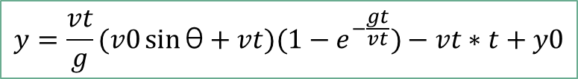
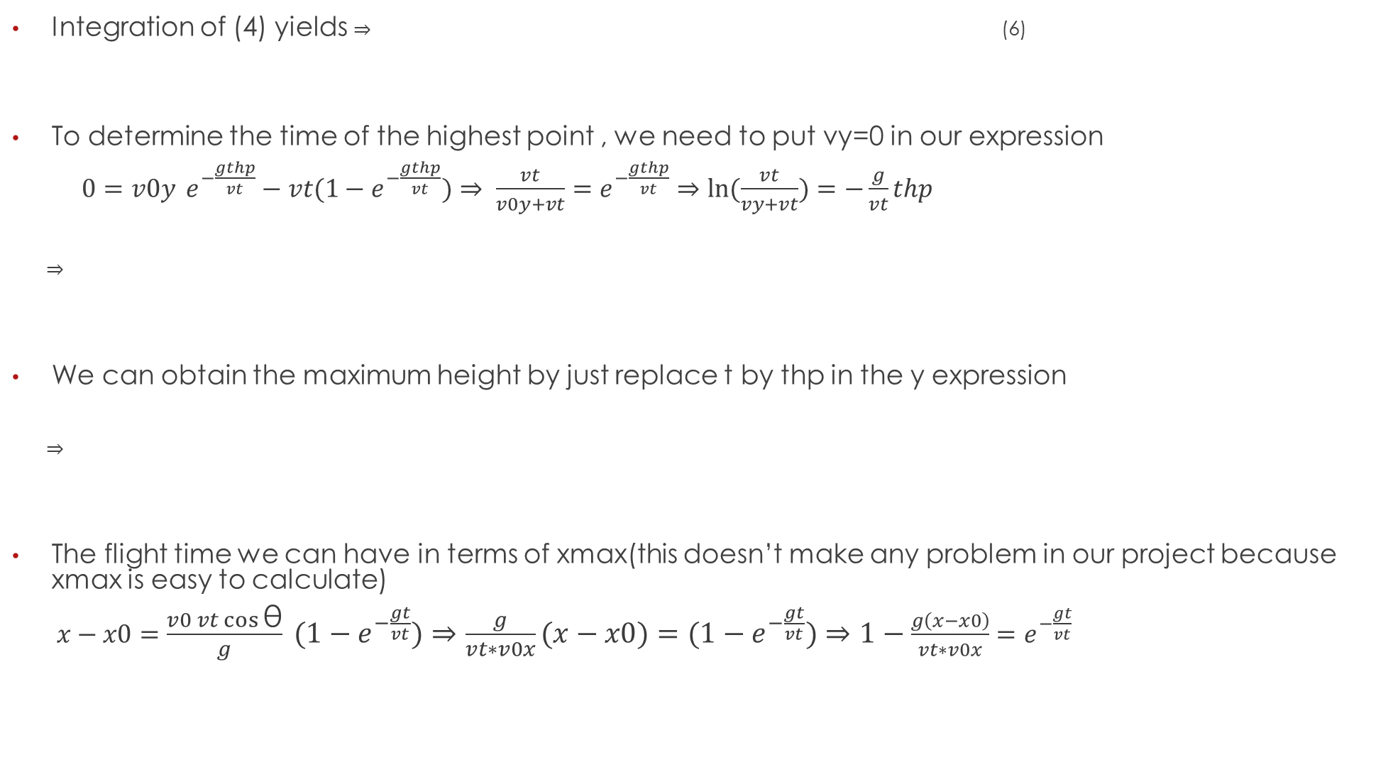
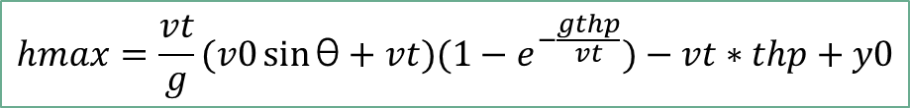
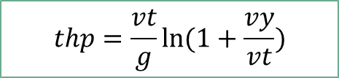
$$y=\frac{vt}{g}(v0\sin{\text{θ}+vt}){(1−e}^{−\frac{gt}{vt}})−vt∗t+y0$$
Integration of (4) yields $⇒$ (6)
To determine the time of the highest point , we need to put vy=0 in our expression
$0=v0y{{ e}^{−\frac{gthp}{vt}}}−vt{(1−e}^{−\frac{gthp}{vt}})⇒ \frac{vt}{v0y+vt}=e^{−\frac{gthp}{vt}}⇒ln⁡(\frac{vt}{vy+vt})=−\frac{g}{vt}thp$
$⇒$
We can obtain the maximum height by just replace t by thp in the y expression
$⇒$
The flight time we can have in terms of xmax(this doesn’t make any problem in our project because xmax is easy to calculate)
$x−x0=\frac{v0 vt\cos{\text{θ}}}{g} {(1−e}^{−\frac{gt}{vt}})⇒\frac{g}{vt∗v0x}(x−x0)={(1−e}^{−\frac{gt}{vt}})⇒1−\frac{g\left(x−x0\right)}{vt∗v0x}=e^{−\frac{gt}{vt}}$
$$thp=\frac{vt}{g}ln⁡(1+\frac{vy}{vt})$$
$$hmax=\frac{vt}{g}(v0\sin{\text{θ}+vt}){(1−e}^{−\frac{gthp}{vt}})−vt∗thp+y0$$

Slide 10
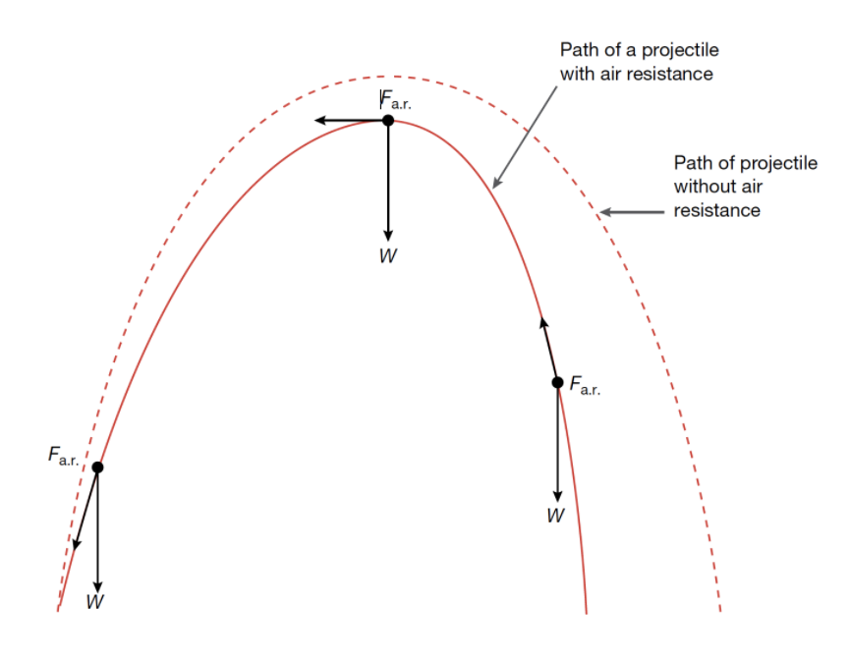
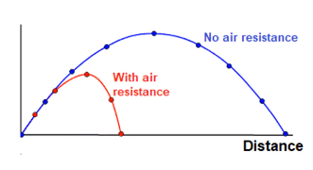
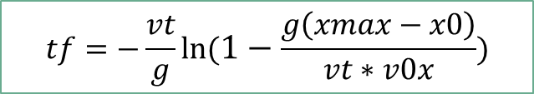

$⇒\ln\left(1−\frac{g\left(x−x0\right)}{vt∗v0x}\right)=−\frac{g}{vt}t⇒t=−\frac{vt}{g}ln⁡(1−\frac{g\left(x−x0\right)}{vt∗v0x})$
if we replace x by xmax $⇒$
$$tf=−\frac{vt}{g}ln⁡(1−\frac{g\left(xmax−x0\right)}{vt∗v0x})$$

Slide 11
Numerical Method used To solve the equations
in numerical analysis, the Runge–Kutta method share a family of implicit and explicit iterative methods, which include the Euler method, used in temporal discretization for the approximate solutions of simultaneous nonlinear equations.
Without Air Resistance:
○ c=0;
○ vt=mg/c=infine;
With Air Resistance:
○ c=constante;
○ vt=mg/c (Existe);

Slide 12
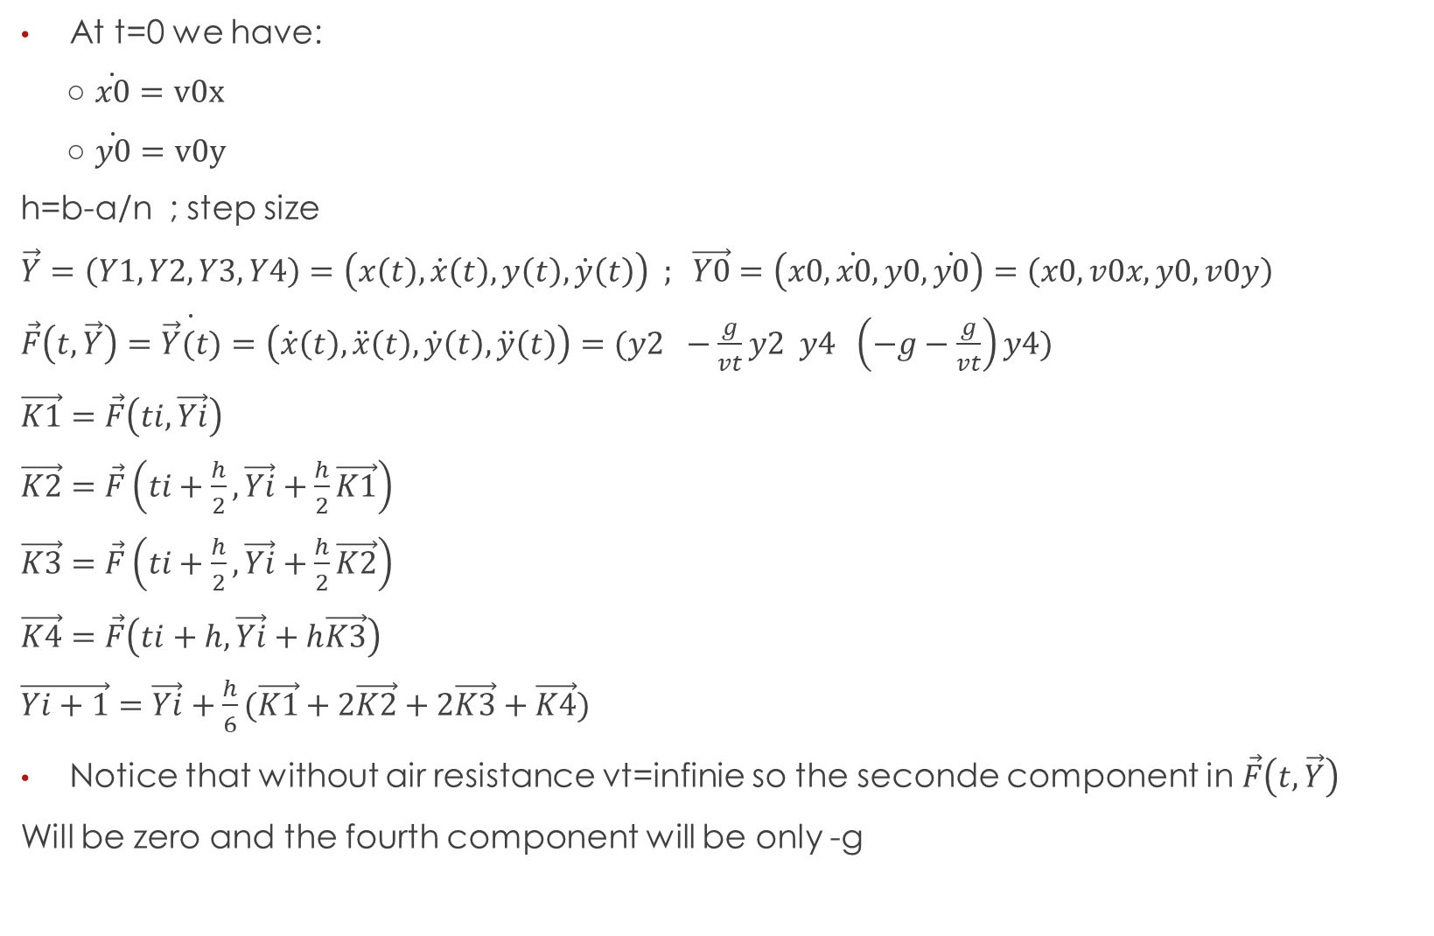
At t=0 we have:
○ $\dot{x0}=v0x$
○ $\dot{y0}=v0y$
h=b-a/n ; step size
$\vec{Y}=\left(Y1,Y2,Y3,Y4\right)=\left(x\left(t\right),\dot{x}\left(t\right),y\left(t\right),\dot{y}\left(t\right)\right) ; \vec{Y0}=\left(x0,\dot{x0},y0,\dot{y0}\right)=\left(x0,v0x,y0,v0y\right)$
$\vec{F}\left(t,\vec{Y}\right)=\dot{\vec{Y}(t)}=\left(\dot{x}\left(t\right),\ddot{x}\left(t\right),\dot{y}\left(t\right),\ddot{y}\left(t\right)\right)=(y2 −\frac{g}{vt}y2 y4 \left(−g−\frac{g}{vt}\right)y4)$
$\vec{K1}=\vec{F}\left(ti,\vec{Yi}\right)$
$\vec{K2}=\vec{F}\left(ti+\frac{h}{2},\vec{Yi}+\frac{h}{2}\vec{K1}\right)$
$\vec{K3}=\vec{F}\left(ti+\frac{h}{2},\vec{Yi}+\frac{h}{2}\vec{K2}\right)$
$\vec{K4}=\vec{F}\left(ti+h,\vec{Yi}+h\vec{K3}\right)$
$\vec{Yi+1}=\vec{Yi}+\frac{h}{6}(\vec{K1}+2\vec{K2}+2\vec{K3}+\vec{K4})$
Notice that without air resistance vt=infinie so the seconde component in $\vec{F}\left(t,\vec{Y}\right)$
Will be zero and the fourth component will be only -g

Slide 13
Main Functions Used In MATLAB
1-TrajectoryCalculation()
Calculates the trajectory of a projectile considering gravity, given the initial horizontal position (x0), initial vertical position (y0), initial velocity (v0), launch angle (theta), planet information (planet), and projectile mass (m). The function uses numerical integration, specifically the Runge-Kutta 4th order method (RK4), to solve the equations of motion. It returns the horizontal (x) and vertical (y) positions over time, total flight time (tf), time at the highest point (th), and maximum height (hmax). Note: Air resistance is not considered.

Slide 14
function [x,y,tf,hmax,th]=TrajectoryFunction(app,x0,y0,v0,theta,planet,m)
g=planet.g;
c=0;
% INITIAL VELOCITY
v0x = v0*cosd(theta);
v0y = v0*sind(theta);
%time of the flight
tf=2*v0y/g;
% time of the highest point
th=tf/2;
% Maximum Height
hmax=(v0^2*sind(theta)^2)/(2*g);
save Variables.mat g c m
if v0<10
b=10;
elseif v0<100
b=50;
elseif v0>=100 && v0<300
b=150;
else
b=200;
end
[Y,t]=RK4(app,@f,x0,v0x,y0,v0y,0,b,100);
y=Y(:,3);
x=Y(:,1);
%DETERMINE XMAX
i=1;
try
while y(i)>=0
xmax=x(i);
i=i+1;
end
catch
% In Case of a big velocity
errordlg("The Initial velocity is to big!");
x=0;y=0;tf=0;hmax=0;
return;
end
%CUT THE VECTORS X AND Y TO ELIMINATE THE NEGATIVE VALUES
y=y(1:i);
x=x(1:i);
% i c'est l'indice pour xmax
end

Slide 15
2-TrajectoryCalculation_AirResistance()
Calculates the trajectory of a projectile with air resistance, taking into account gravity, drag coefficient (cd), air density (rho), surface area (A), and projectile mass (m). The function uses the Runge-Kutta 4th order method (RK4) for numerical integration. It returns the horizontal (x) and vertical (y) positions over time, total flight time (tf), time at the highest point (th), and maximum height (hmax). The function accounts for the effects of air resistance on the projectile's motion.
3-PlotTrajectory()
The PlotTrajectory function visualizes the trajectory of a projectile using the provided x and y coordinates. It adjusts the plot axes, adds labels, and animates the projectile's movement using an animated line object. This function enhances the user experience by presenting a clear and engaging visualization of the projectile's path.
4-Rk4()
The "RK4" function implements the fourth-order Runge-Kutta method for numerical integration. It takes initial values and an integration interval and approximates the solution by iteratively evaluating the derivative function. The results are stored in arrays and returned as the output.

Slide 16
function [x,y,tf,hmax,th]=TrajectoryCalculation_AirResistance (app,x0,y0,v0,theta,planet,m)
g=planet.g;
cd=planet.drag_coefficient;
%DRAG COEFFICIENT
rho=planet.air_density;
A=0.043;%SURFACE OF THE BALL
c=0.5*cd*rho*A;
vt=(m*g)/c;
%INITIAL VELOCITY
v0x = v0*cosd(theta);
v0y = v0*sind(theta);
%TIME OF THE HIGHEST POINT
th=(vt/g)*log(1+v0y/vt);
%MAXIMUM HEIGHT
hmax=(vt/g)*(v0y+vt)*(1-exp(-(g/vt)*th))-vt*th+y0;
save Variables.mat g c m
if v0<100
b=30;
elseif v0>=100 && v0<300
b=100;
else
b=150;
end
[Y,t]=RK4(app,@f,x0,v0x,y0,v0y,0,b,100);
y=Y(:,3); x=Y(:,1);
%DETERMINE XMAX
i=1;
try
while y(i)>=0
xmax=x(i);
i=i+1;
end
catch
% In Case of a big velocity
errordlg("The Initial velocity is to big!");
x=0;y=0;tf=0;hmax=0;
return;
End
%TIME FLIGHT
tf=(-vt/g)*log(1-((g*(xmax-x0))/(v0x*vt)));
%CUT THE VECTORS X AND Y TO ELIMINATE THE NEGATIVE VALUES
y=y(1:i); x=x(1:i);
end

Slide 17
function PlotTrajectory(app,x,y)
function [y,t]=RK4(app,fx,x0,v0x,y0,v0y,a,b,N)
xlim(app.UIAxes,[0,max(x)*1.1+1]);
ylim(app.UIAxes,[0,max(y)*1.1+1]);
xlabel(app.UIAxes,'X position en(m)');
ylabel(app.UIAxes,'Y position en(m)')
% Create an animated line object for the animation
ax=app.UIAxes;
ball = animatedline(ax, 'Marker', 'o', 'MarkerSize', 5,'Color','[0.36,0.76,0.36]');
for i = 1:length(x)
% Update the animated line with new points
if isvalid(ball)
addpoints(ball, x(i), y(i));
drawnow;
pause(0.05);
% Adjust the pause duration to control the animation speed
else
break
% stop trying to add points
end
end
end
h=(b-a)/N;
y = zeros(N,4);
y(1,:)=[x0 v0x y0 v0y];t(1)=a;
for i=1:N
t(i+1)=a+i*h;
k1=feval(fx,app,t(i),y(i,:));
k2=feval(fx,app,t(i)+h/2,y(i,:)+(h/2).*k1');
k3=feval(fx,app,t(i)+h/2,y(i,:)+(h/2).*k2');
k4=feval(fx,app,t(i)+h,y(i,:)+h.*k3');
y(i+1,:)=y(i,:)+(h/6)*(k1+2*k2+2*k3+k4)';
end
end

Slide 18
5-f()
The ‘f’ function represents the differential equations for projectile motion. It computes the derivatives of the position and velocity variables in the x and y directions. The equations consider the effects of gravity and air resistance, determined by ‘g’ ,‘k’ and ‘m’ . The derivatives are calculated based on the current state variables and the equations of motion with and without air resistance.
6-Planets_Info
This script defines properties for various planets in a struct format, including their names, masses, gravitational accelerations, atmospheric compositions, air densities, and drag coefficients. The planets covered are Mercury, Venus, Earth, Mars, Jupiter, Saturn, Uranus, and Neptune. These properties are stored in individual structs and combined into a cell array named "planets". Later on, the script can be called to obtain the "planets" cell array, which contains the struct information for each planet.
7-Show Images()
displays images based on the maximum distance (xmax) and maximum height (ymax) achieved by the projectile. It shows the Giza Pyramid for distances over 500m and heights over 139m, the Leaning Tower of Pisa for distances over 200m and heights over 56m, an airplane for distances over 100m and heights over 12.5m, and a car for distances over 25m and heights over 1.5m. It provides visual references for the scale of the ball's travel.

Slide 19
Planets_Info.m
mercury.name = 'Mercury';
mercury.g = 3.7; % m/s^2
mercury.atmosphere = 'none';
mercury.air_density = 0.0012; % kg/m^3
mercury.drag_coefficient = 0.47; % coefficient of drag for a sphere
venus.name = 'Venus';
venus.g = 8.87; % m/s^2
venus.atmosphere = 'carbon dioxide';
venus.air_density = 65; % kg/m^3
venus.drag_coefficient = 0.47;
earth.name = 'Earth';
earth.g = 9.81; % m/s^2
earth.atmosphere = 'air';
earth.air_density = 1.225; % kg/m^3
earth.drag_coefficient = 0.47;
mars.name = 'Mars';
mars.g = 3.71; % m/s^2
mars.atmosphere = 'carbon dioxide';
mars.air_density = 0.02; % kg/m^3
mars.drag_coefficient = 0.47;
jupiter.name = 'Jupiter';
jupiter.g = 23.1; % m/s^2
jupiter.atmosphere = 'hydrogen';
jupiter.air_density = 0.3; % kg/m^3
jupiter.drag_coefficient = 0.47;
saturn.name = 'Saturn';
saturn.g = 9; % m/s^2
saturn.atmosphere = 'hydrogen';
saturn.air_density = 0.15; % kg/m^3
saturn.drag_coefficient = 0.47;
uranus.name = 'Uranus';
uranus.g = 8.7; % m/s^2
uranus.atmosphere = 'hydrogen';
uranus.air_density = 0.3; % kg/m^3
uranus.drag_coefficient = 0.47;
neptune.name = 'Neptune';
neptune.g = 11.0 ; % m/s^2
neptune.atmosphere = 'hydrogen';
neptune.air_density = 0.48;
neptune.drag_coefficient = 0.47;
% Combine planet structures into a cell array
planets = {mercury, venus,earth, mars,jupiter,saturn,uranus,neptune};

Slide 20
function ShowImages(app,xmax,ymax)
else
app.Image.Visible=false;
app.Image.ImageSource='';
app.length_width.Visible=false;
end
end
if xmax>500 && ymax>139
%show the Giza Pyramid image
app.Image.ImageSource='Images_used\giza_pyramid.png';
app.Image.Visible=true;
app.length_width.Value="H=139m , Base=230m";
app.length_width.Visible=true;
elseif xmax>200 && ymax>56
%show the Leaning Tower of Pisa with heigh 56m
app.Image.ImageSource='Images_used\tower.jpeg';
app.Image.Visible=true;
app.length_width.Value="H=56m";
app.length_width.Visible=true;
elseif xmax>100 && ymax>12.5
%show the plane of height 12.5m and length of 39.5m
app.Image.ImageSource='Images_used\plane.jpeg';
app.Image.Visible=true;
app.length_width.Value="H=12.5m,L=39.5m";
app.length_width.Visible=true;
elseif xmax>25 && ymax>1.5
%show the car of height 1.5m and length of 3.5m
app.Image.ImageSource='Images_used\car.jpeg';
app.Image.Visible=true;
app.length_width.Value="H=1.5m , L=3.5m";
app.length_width.Visible=true;
function dy=f(app,t,y))
load Variables;
dy = zeros(4,1); % a column vector
dy(1) = y(2);
dy(2) = -c*y(2)/m;
dy(3) = y(4);
dy(4)=-g-c*y(4)/m;
end

Slide 21
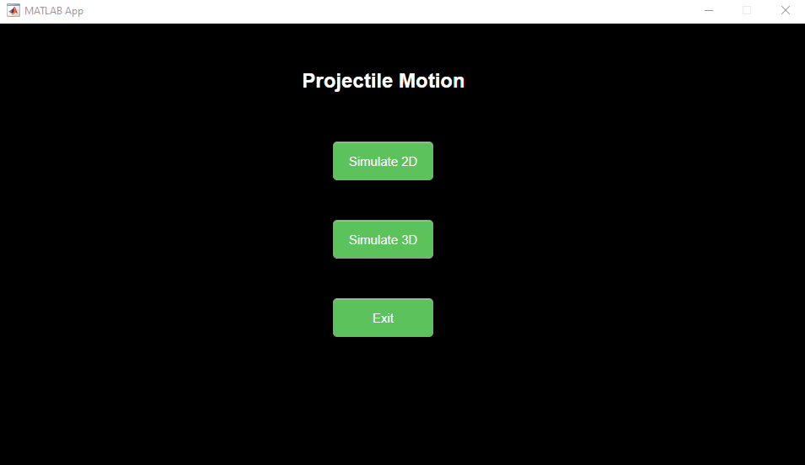
Graphical User Interface
The main window of the app features three buttons: one for 2D simulation, one for 3D simulation, and one for exiting the application. These buttons provide access to different simulation modes and allow the user to navigate through the app's functionalities easily.

Slide 22
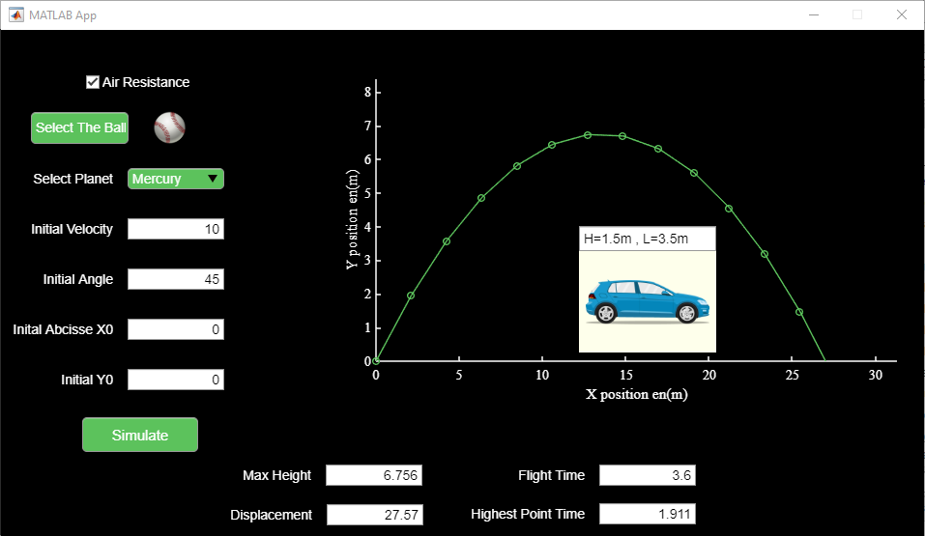
After clicking the "2D simulation" button, the app launches a simulation environment that displays the trajectory of a projectile in a 2D plane. The user can input initial parameters such as velocity and angle to visualize and analyze the projectile's motion. The simulation provides a visual representation of the projectile's path, allowing users to study its trajectory and observe its behavior in a two-dimensional space.

Slide 23
The "Air Resistance" checkbox enables/disables the consideration of air resistance in
the simulation.
The "Select a Ball" button allows users to choose between baseball, soccer ball, and basketball, influencing the object's mass in the simulation.
The "Select Planet" button allows users to choose a planet as the environment for the projectile motion simulation.
Initial velocity: The initial speed at which the object is launched. (User Input )
Initial angle: The angle at which the object is launched with respect to the horizontal axis. ( User Input )
Initial x-coordinate (x0): The starting position of the object along the horizontal axis. ( User Input )
Initial height (y0): The starting height of the object above the ground. ( User Input)
Max Height: The maximum height reached by the projectile during its trajectory. ( User Output )
Flight Time: The total time the projectile remains in the air before it lands. ( User Output )
Displacement: The horizontal distance covered by the projectile from its initial position to the point where it lands. ( User Output )
Highest Point Time: The time at which the projectile reaches its maximum height during the trajectory. ( User Output )
The "Simulate" button initiates the calculation and visualization of the selected ball's trajectory, accounting for air resistance and different ball masses.

Slide 24
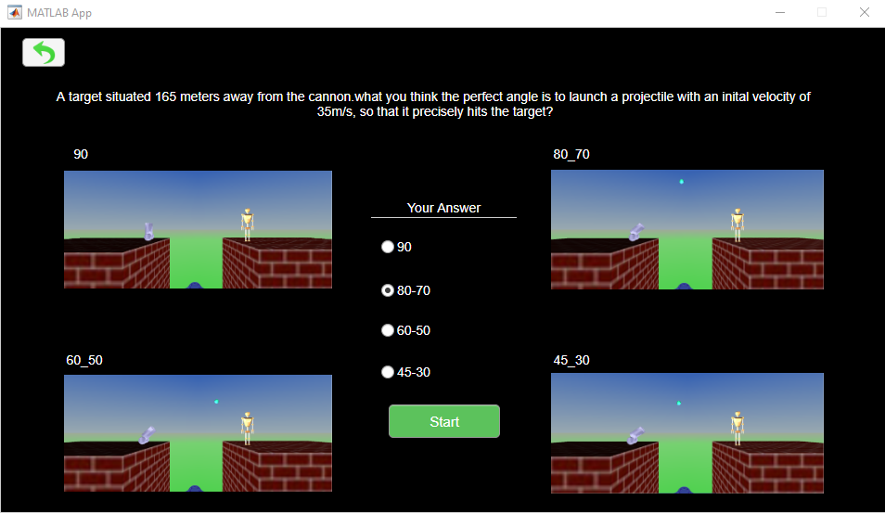
After clicking the "3D Simulation" button, a new form is displayed with an intriguing question presented as a riddle. The user is prompted to select the answer from a group of radio buttons. Once the user has chosen their answer, they can click the "Start" button to initiate the captivating 3D simulation experience.

Slide 25
3D Simulink Model
The Simulink model utilized for the 3D simulation consists of essential components such as integrators, constants, summing blocks, MATLAB functions, product blocks, creators, VR Sink, and VR Signal Expander. These components collectively enable mathematical operations, data manipulation, and visualization in a 3D context. The VR Sink and VR Signal Expander serve to interface with the VRML (Virtual Reality Modeling Language) file format, facilitating the presentation of simulation results within an immersive 3D environment.

Slide 26
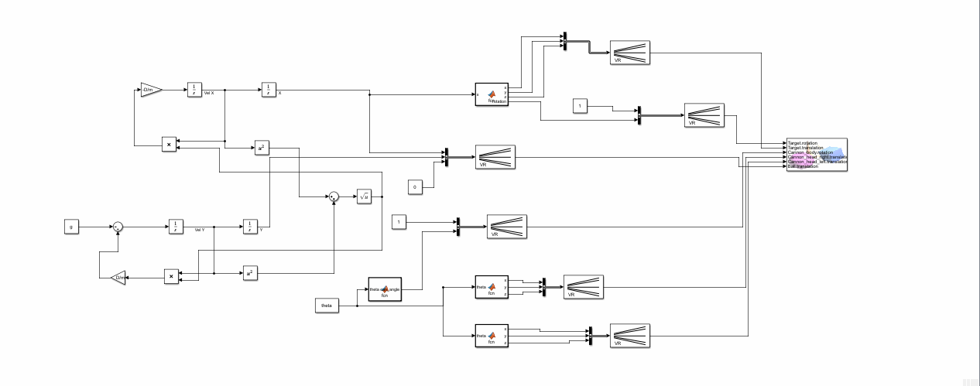

Slide 27
Results
For this simulation notice how the including of air resistance doesn’t have any affect on the trajectory because as we saw in our planets info script the air in mercury is negligeable it almost has no air.

Slide 28
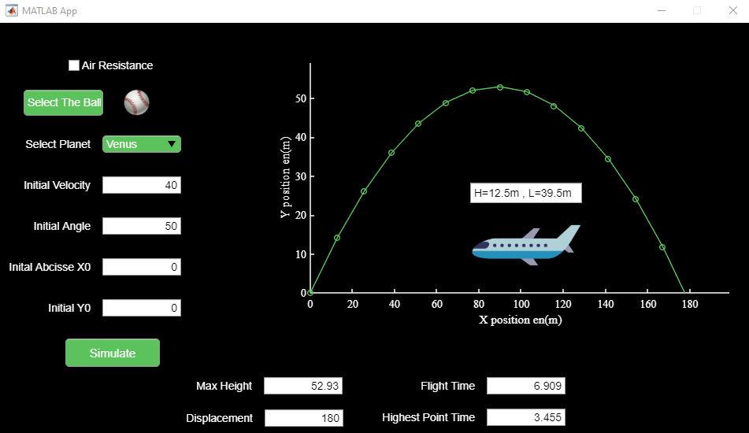
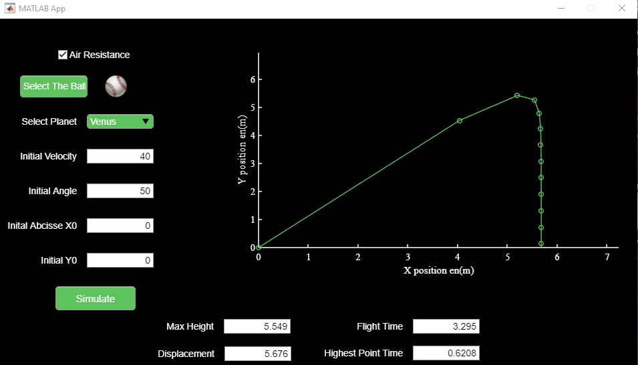
For this example the including of air resistance have big affectation on the trajectory of the ball because of the huge air density of the selected planet ‘venus’.

Slide 29
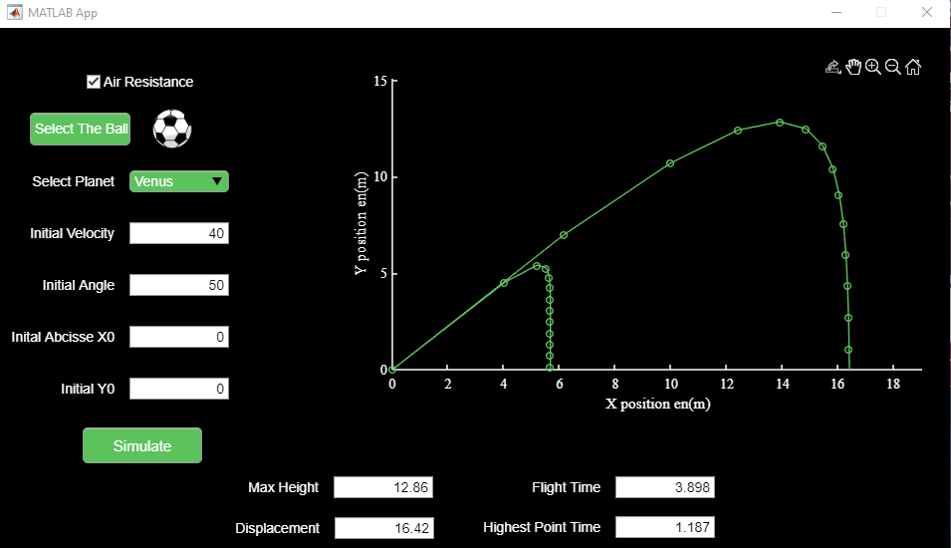
In this example, we explore the impact of the selected ball's mass (baseball, soccer, or basketball) on the trajectory, taking into account the influence of air resistance.

Slide 30
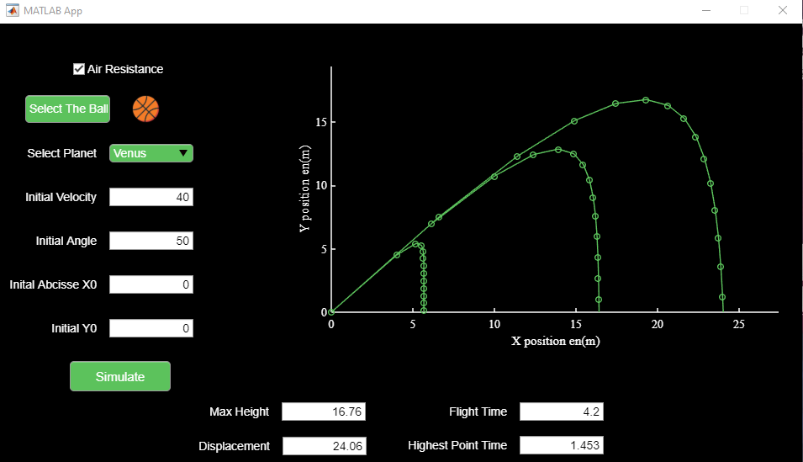
Notice the reduced impact of air resistance on the trajectory as the mass of the selected ball increases, highlighting the significance of mass in mitigating the effects of air resistance.

Slide 31
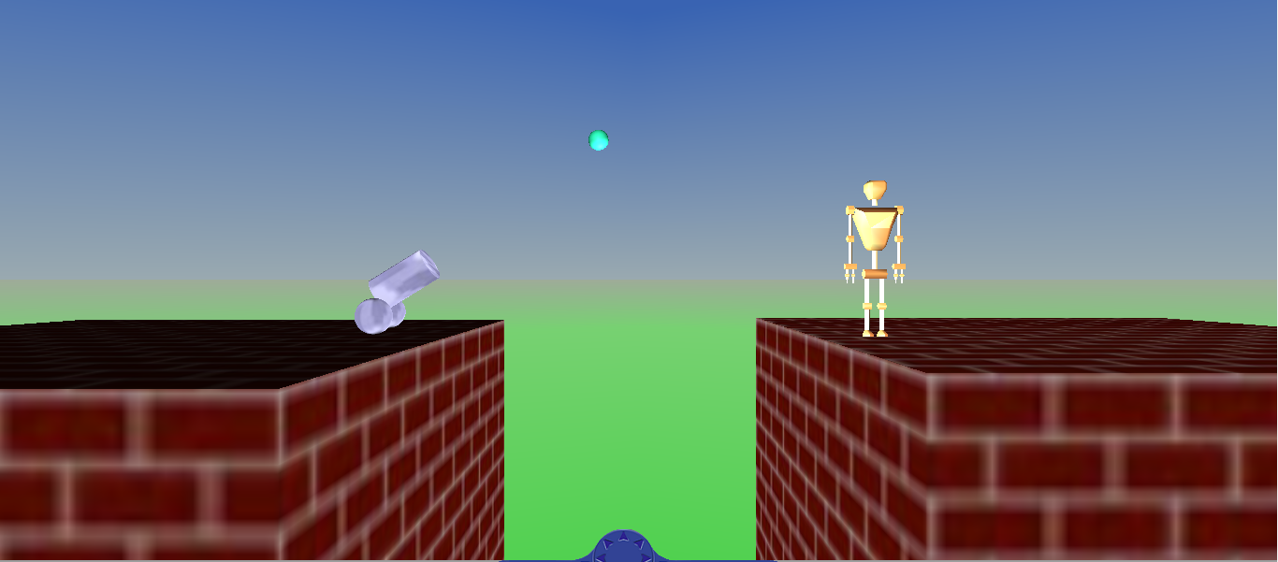
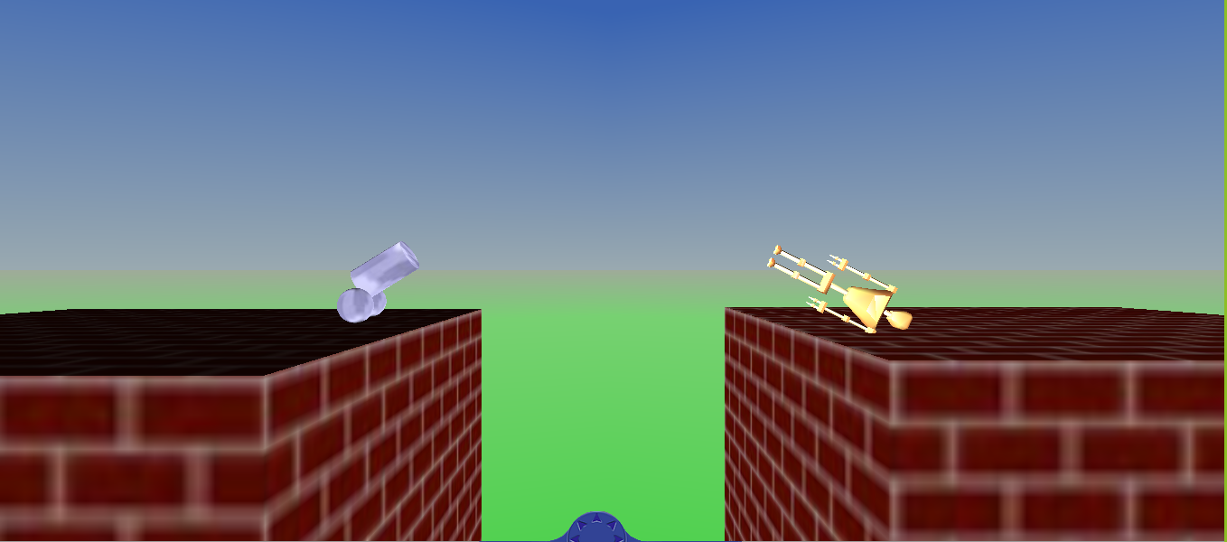
This example demonstrates that using an angle of 45 degrees allows us to accurately hit the target in the 3D simulation. By finding the optimal launch angle, we achieve maximum range and accuracy. The results highlight the importance of projectile motion calculations in achieving desired outcomes.
After successfully hitting the target, a captivating animation resembling a "die" motion is displayed, adding an element of visual engagement to the simulation.

Slide 32
References
Introduction_To_ProjectilMotion
Throw_a_ball_in_space
Projectile_WithoutAirResistance
Projectile_WithAirResistance
WithAirResistance_Formulas
Simulink3D_Tutorial

Slide 33
Thanks for your attention!.

